Slide 1
Strategies for Instituting a Culture of Plain Language
DOJ Civil Rights Division
Daniel H. Yi
Senior Counsel for Legal Innovation
1

Slide 2
About the Civil Rights Division
The challenge
Our hypothesis
What we’re seeing so far
2

Slide 3
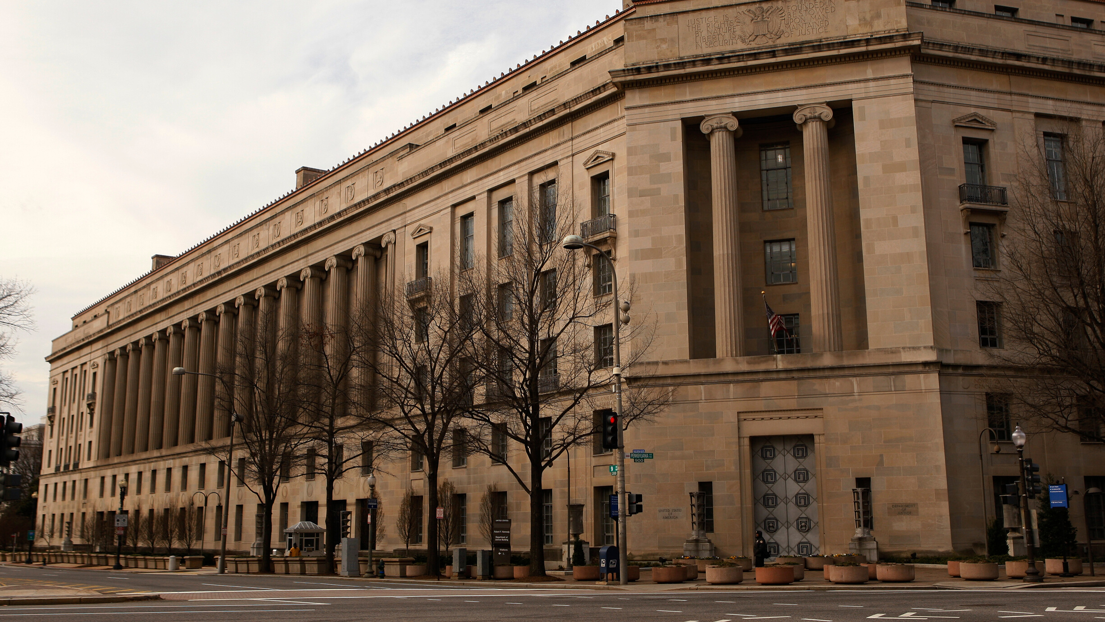
About the Civil Rights Division
3

Slide 4
Short version of the Mission
Uphold the federal laws that protect you from discrimination based on your:
race, color, national origin, disability status, sex, religion, familial status, or loss of other constitutional rights.
Cover areas like:
Voting / Housing / Employment / Education / Policing / Hate Crimes / Trafficking
Is made up of:
~600 People (~375 lawyers, ~225 allied professionals)
We do this through:
Enforcement / Outreach & Education / Coordination
4

Slide 5
The challenge
5

Slide 6
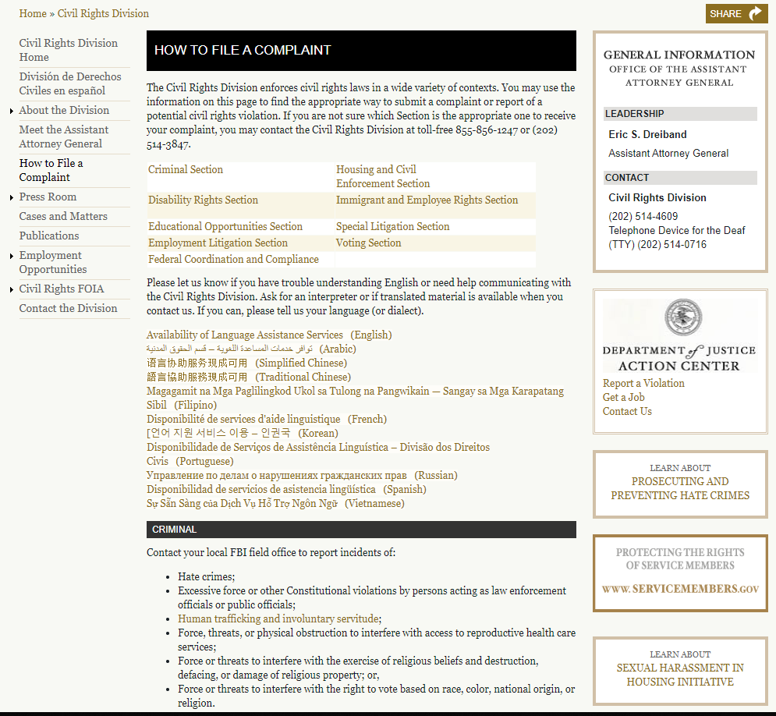
Webpage view for Civil Rights how to file a complaint page
6

Slide 7
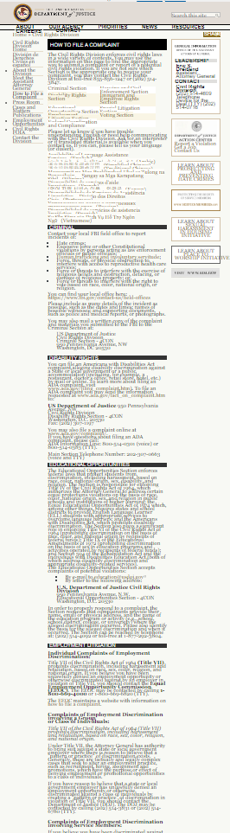
Web Page layout
7

Slide 8
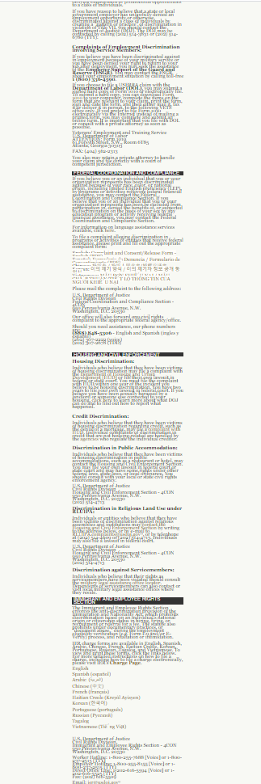
Web Page layout 2
8

Slide 9
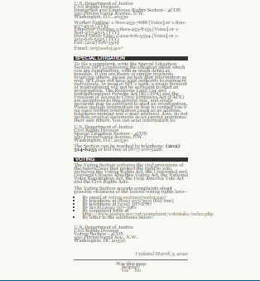
Web Page layout 3
9

Slide 10
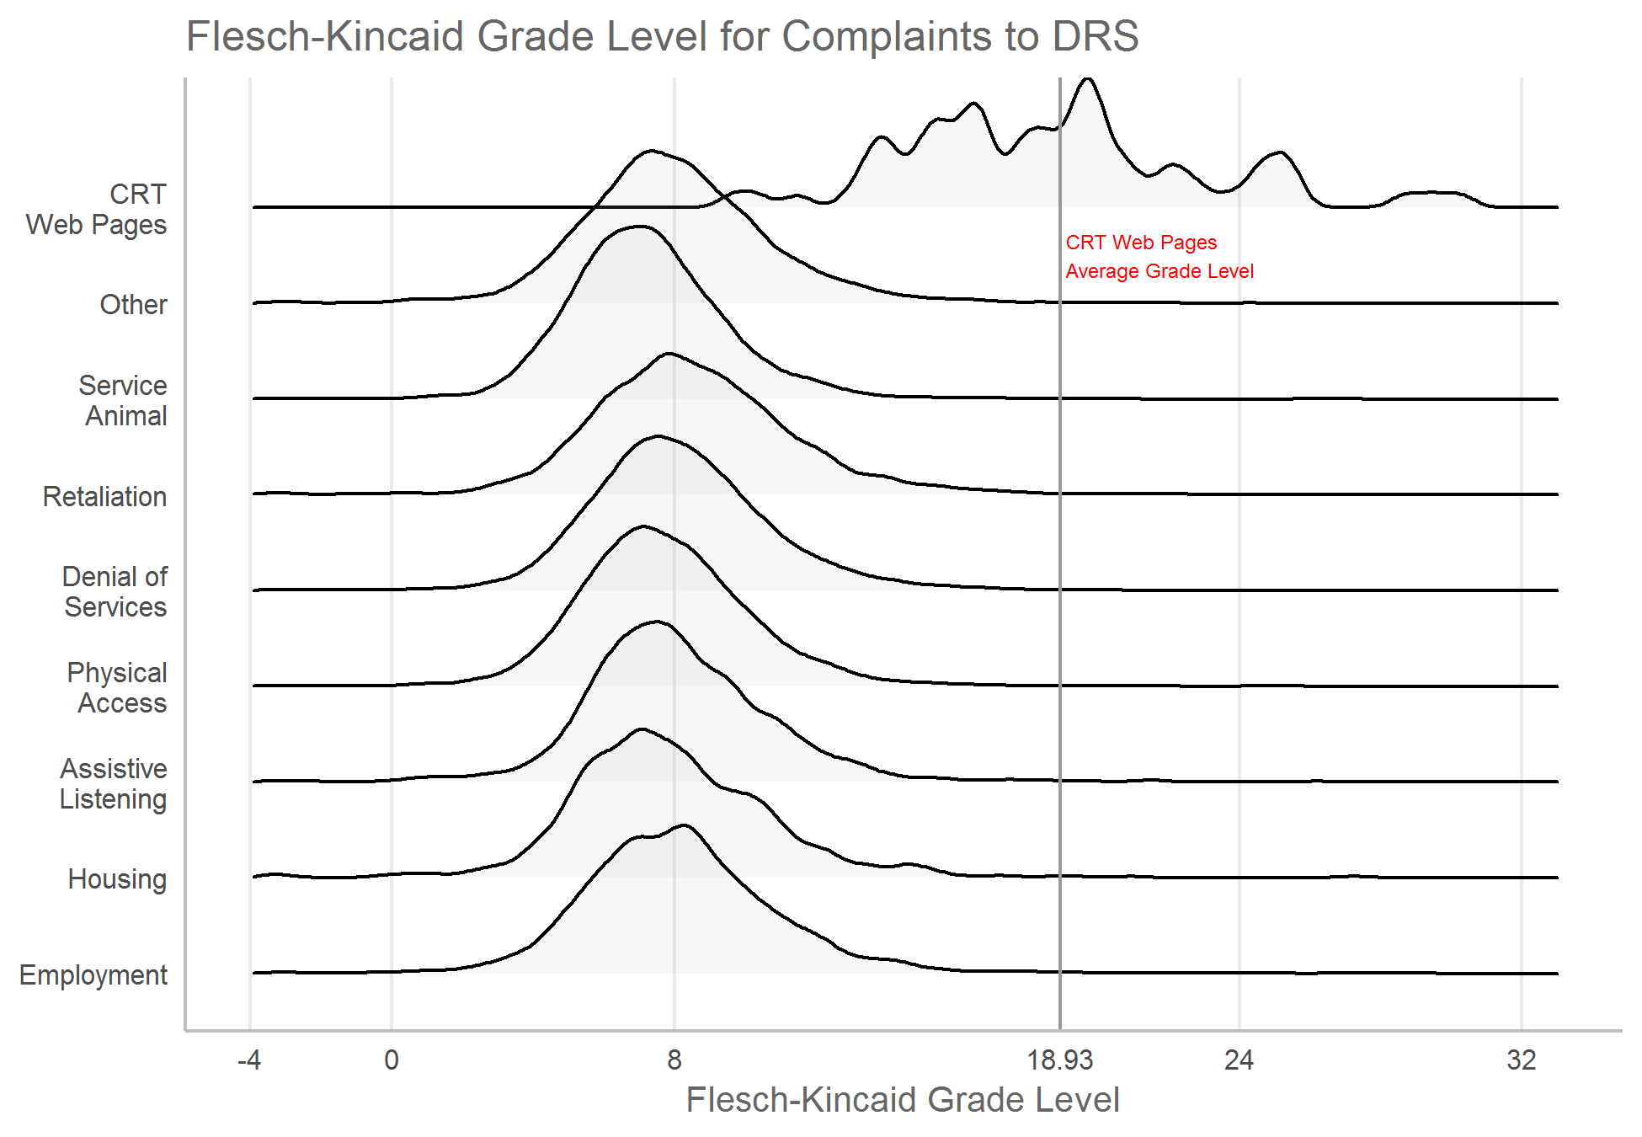
Flesch-Kincaid Grade Level for Complaints
10

Slide 11
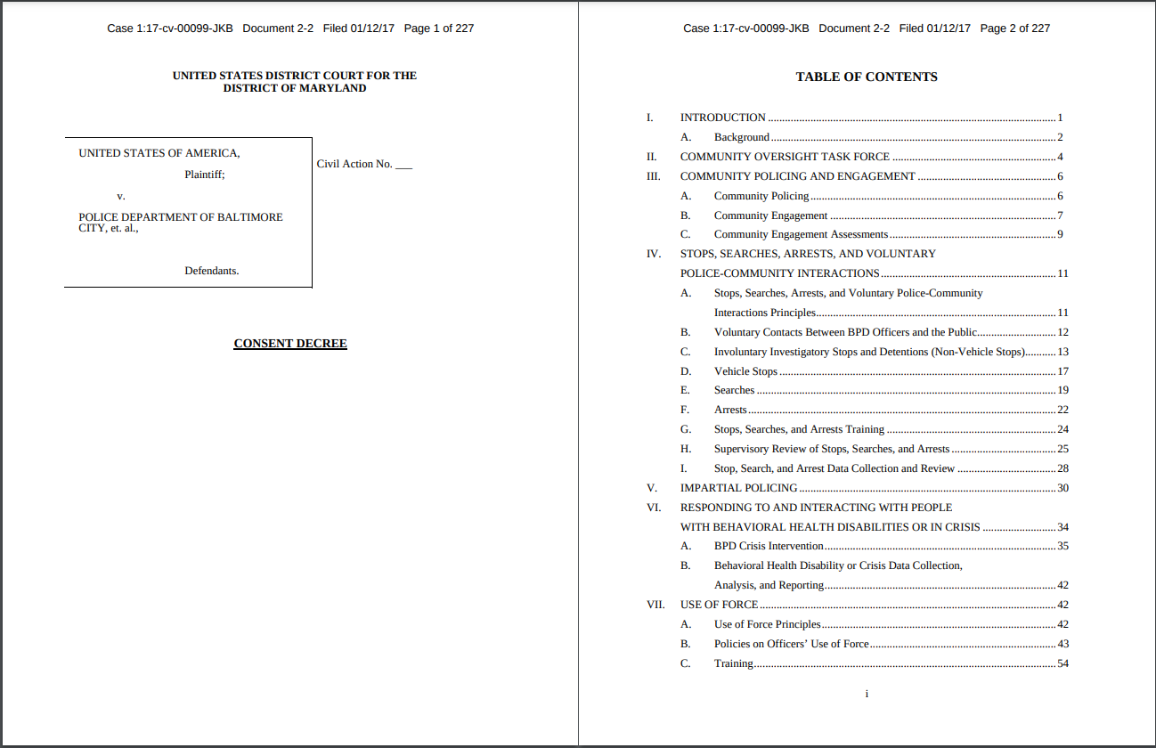
Consent Decree Example
11

Slide 12
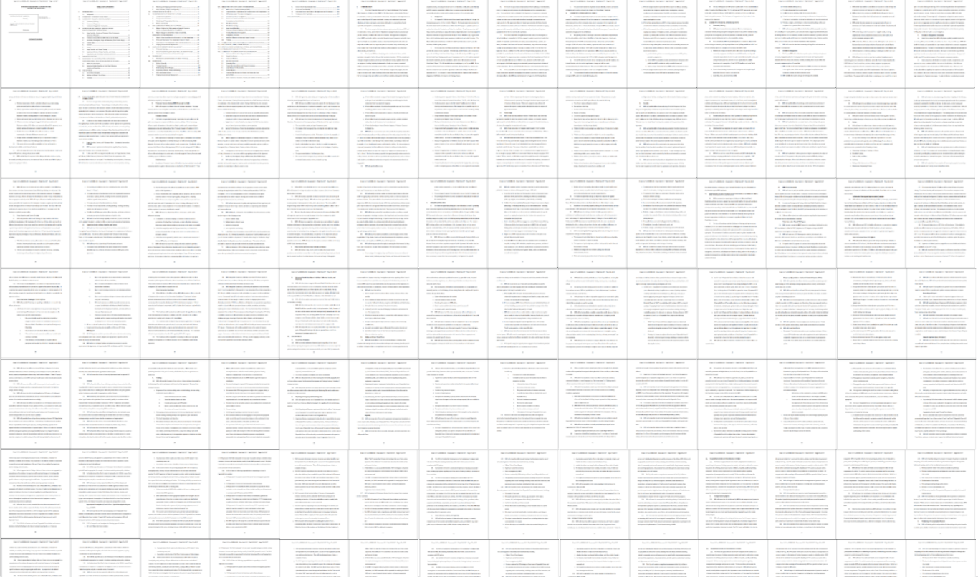
Consent Decree Continued
12

Slide 13
Our hypothesis
13

Slide 14
Purpose
Communication is at the core of what we do. We produce an overwhelming amount of writing every day, at great effort and expense.
Quite a bit of this writing is aimed at helping people understand what they can and cannot do.
We can achieve greater impact if our writing is clear and actionable for the intended reader, not for ourselves.
14

Slide 15
Tactics
Start with the uncontroversial stuff and then build out.
For us: intranet, policies, even emails!
While working on the uncontroversial stuff, build the infrastructure to make this as easy as possible.
For us: style guide, templates, community of practice, new roles and skills, testing practices
Lean on outside validators as you go.
For us: user testing, Center for Plain Language
15

Slide 16
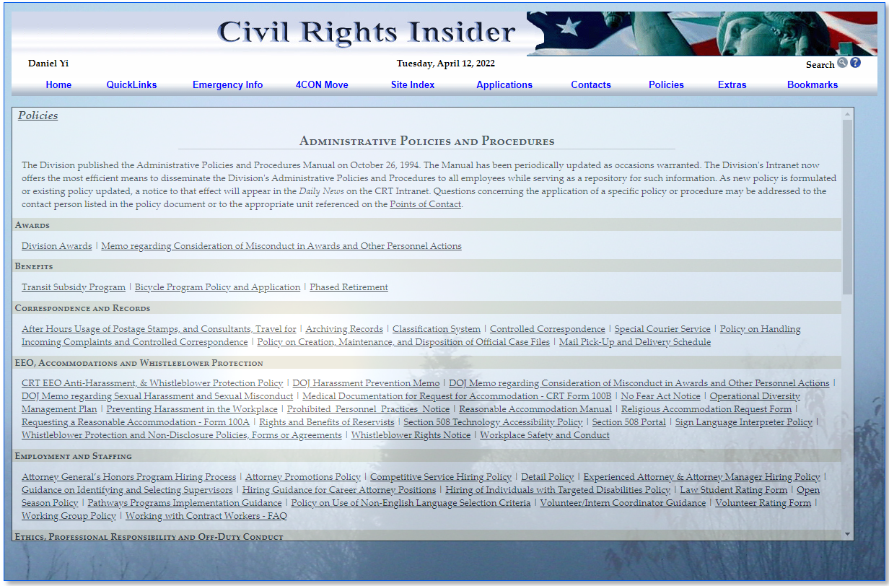
Civil Rights Insider Webpage
16

Slide 17
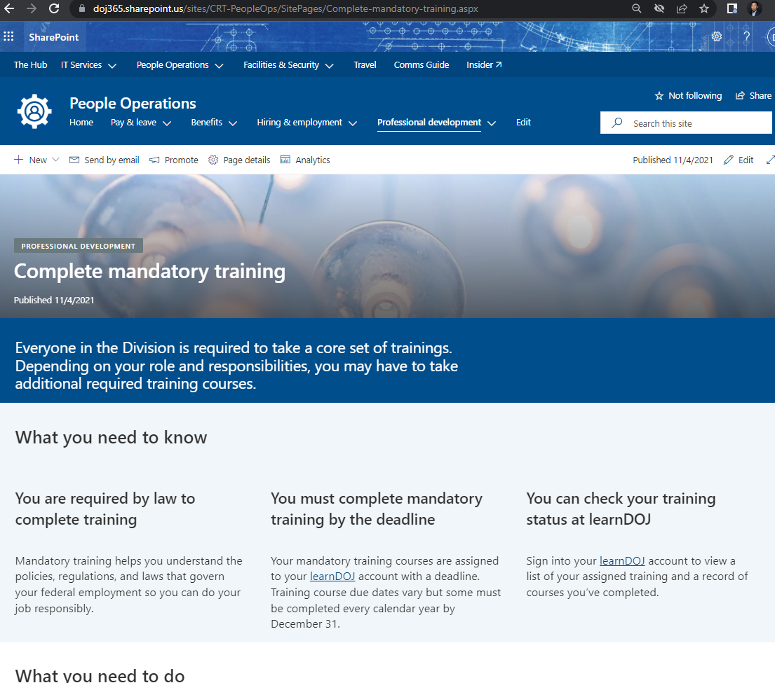
Civil Rights division page for training modules
17

Slide 18
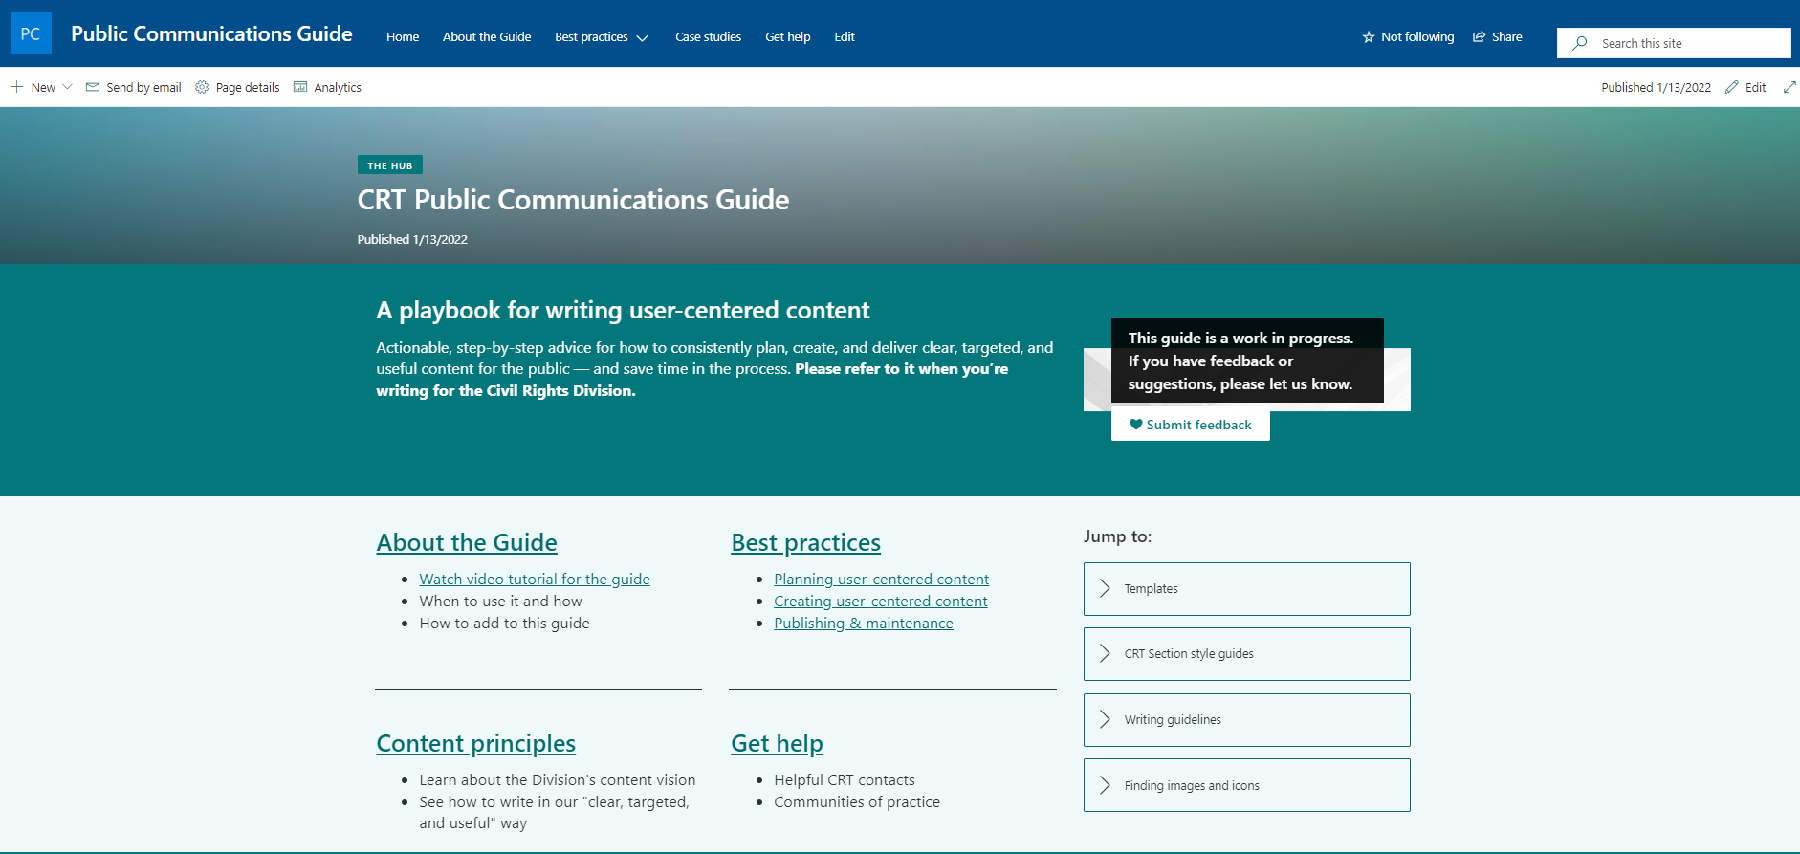
CRT Public Communications Guide page
18

Slide 19
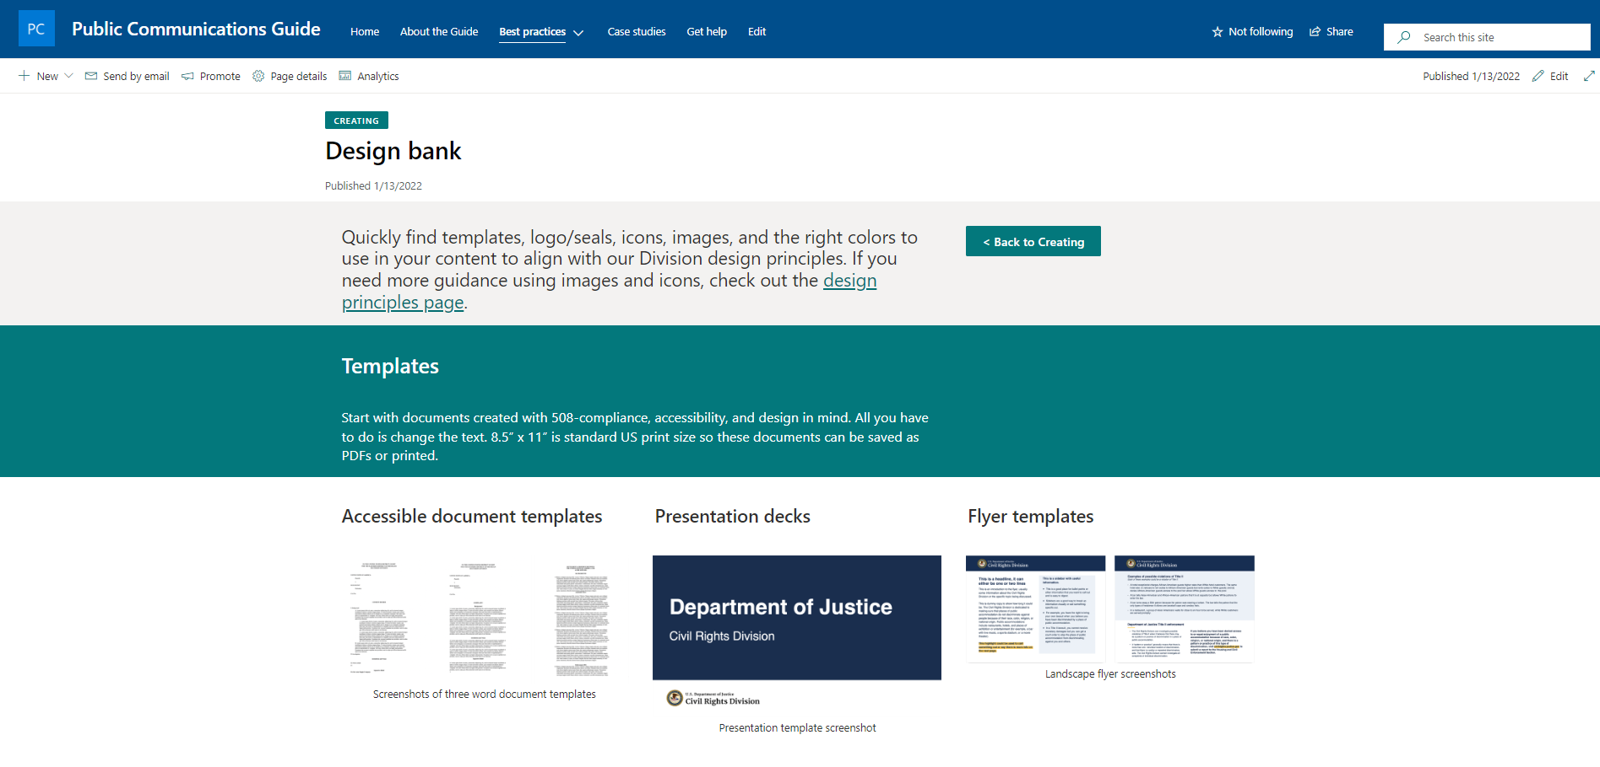
Design Bank
19

Slide 20
CRT Public Communications Guide
20

Slide 21
CRT Public Communications Guide page – Design Bank Continued 2
21

Slide 22
CRT Public Communications Guide page – Design Bank Continued 3
22

Slide 23
Web Page layout 3
9

Slide 24
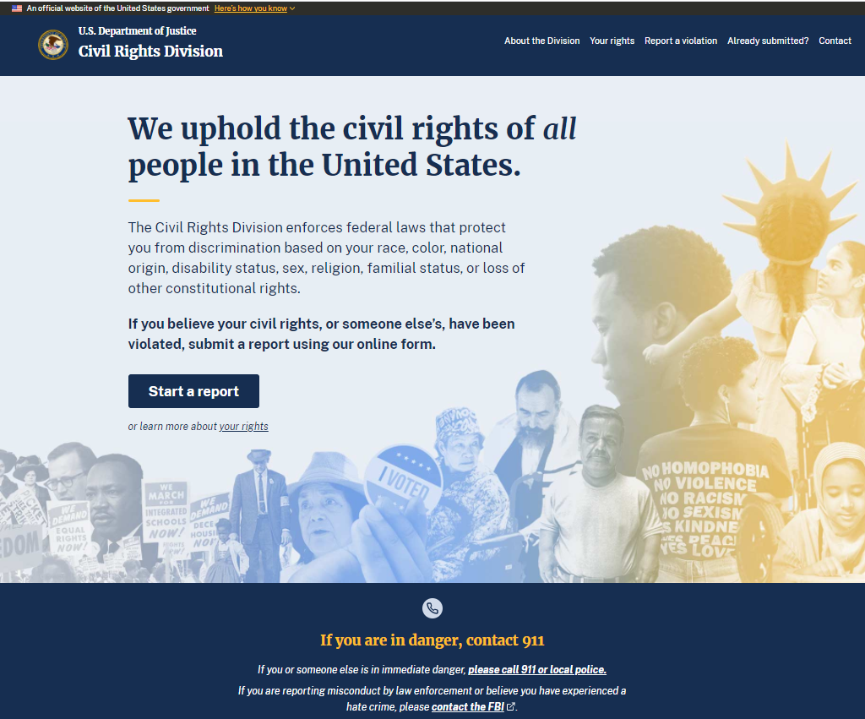
Civil Rights Division Page to Start a Report

Slide 25
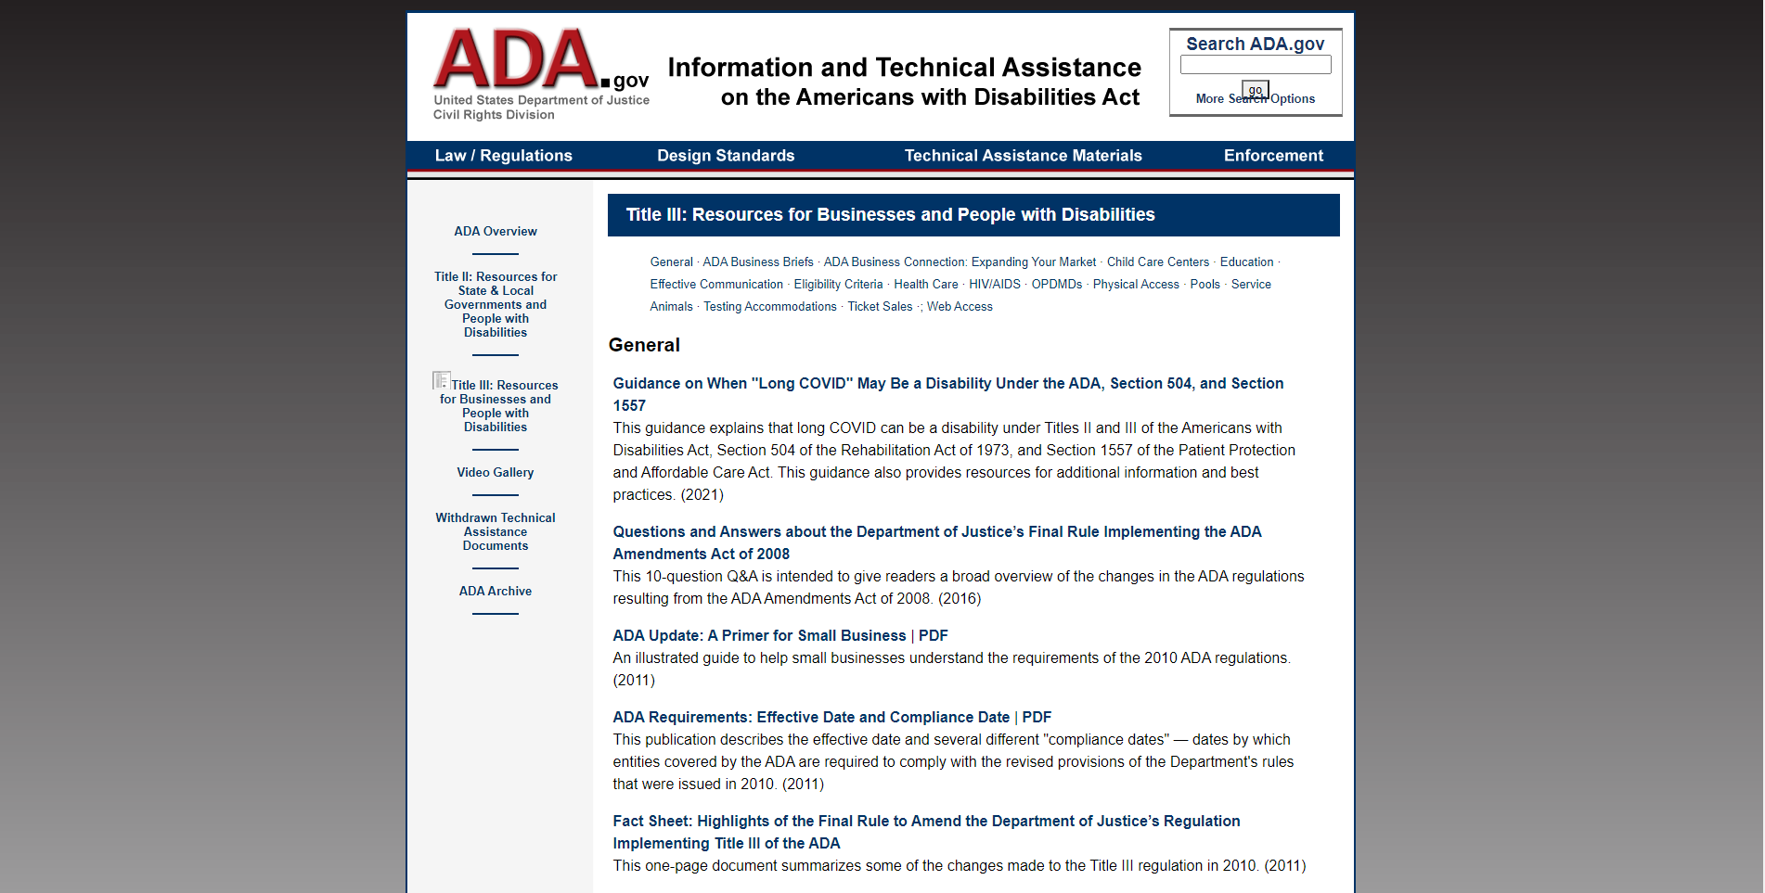
ADA: Information and Tech Assistance
25

Slide 26
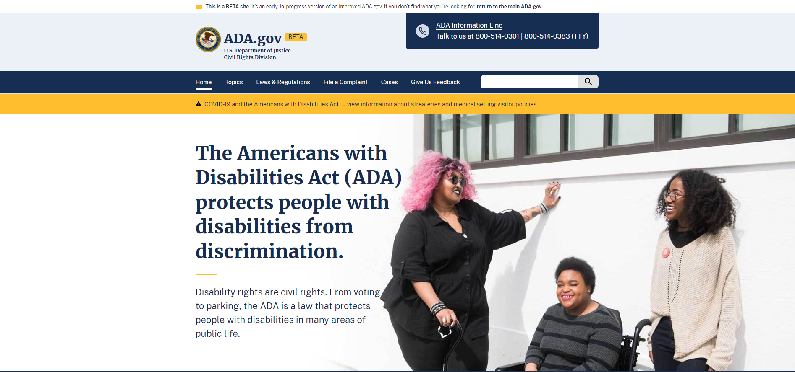
ADA.gov page – Americans with Disabilities

Slide 27
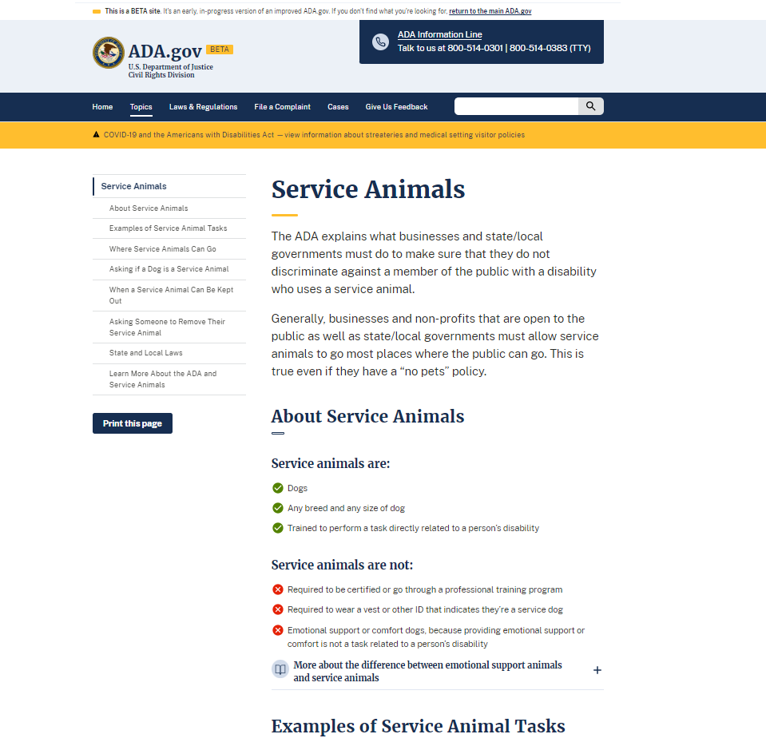
ADA.gov Page: Service Animals

Slide 28
PUBLIC COMMENTS
“This is the best government website interface page I have ever seen. It was very easy to understand and well designed. Thank you to everyone involved with producing and managing it and thanks to everyone in the DOJ for their sustained commitment to truth and justice.”
- Public

Slide 29
PUBLIC COMMENTS CONTINUED
Best government created site I have ever used; clean, sharp, clear, well done. Thank you for you service.
- Public

Slide 30
DOJ Strategic Plan
“The Department will emphasize user-centered design practices and plain
language to ensure that its public-facing technology tools provide clear, concise,
and usable information to the public.”

Slide 31
DOJ Key Performance Indicator
Percent of Department websites reflecting U.S. Web Design System requirements and meeting best practices for plain language

Slide 32
What we’ve learned…and are wondering!
32

Slide 33
Takeaways
The story of “Hub U”
What is the right long term support model?
What is the right way to change workflow, if at all?
33

