Slide 1
Simplifying User Experiences at USA Gov
Simplifying user experiences for complex content at USAGov

Slide 2
Introductions: Joanne and Dita
Joanne McGovern
Mercedita Andrew
UX Researcher
USAGov
she/her
Contractor, UX Researcher
USAGov
she/her

Slide 3
Defining the problem
1
Defining the problem

Slide 4
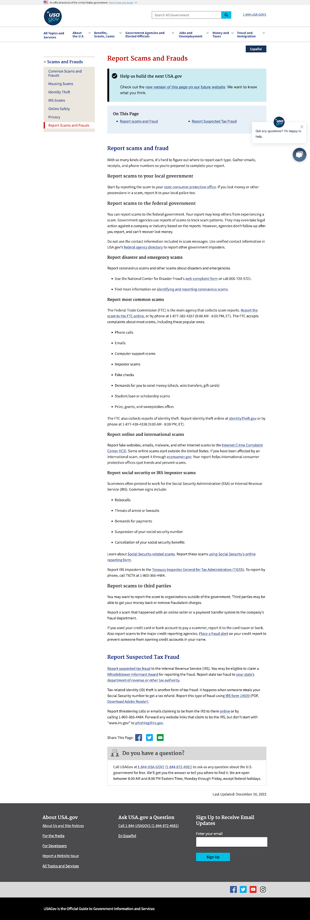
Defining the problem: description
Defining the problem
The page content is complex
Plus the page is long and pretty dense
And the user could be in an emotional state

Slide 5
Simplicity
Simplicity is how well you deal with the challenges of complexity.

Slide 6
Content design
2
Content design

Slide 7




USA Gov content design process
Cross functional teams
Deep dive into data to learn about audience and intents
Develop prototypes
Review and approve
before content is written

Slide 8
Human-centered design
Human-Centered Design is a creative problem-solving process that begins with understanding human needs and ends with innovative solutions to address those needs.

Slide 9
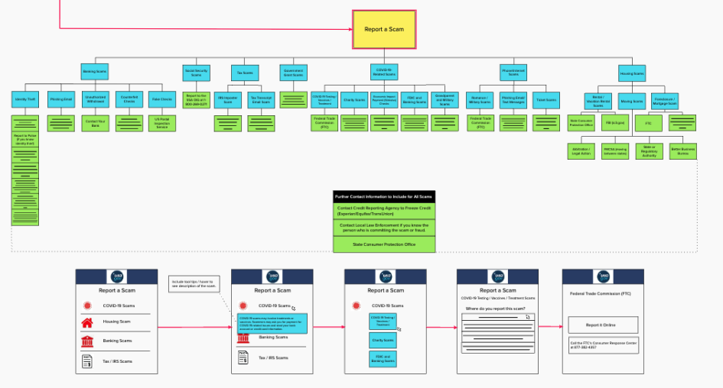
Imagining a solution

Slide 10
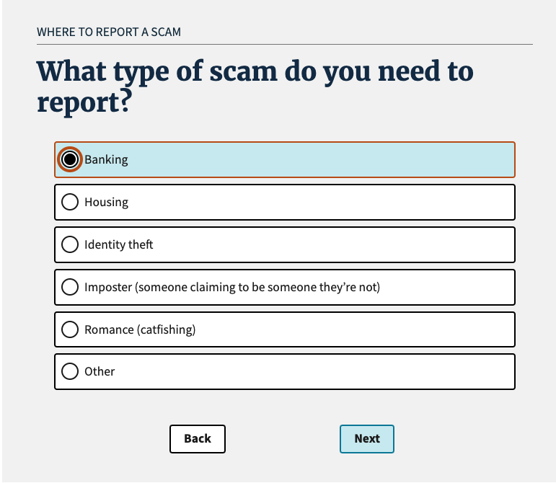
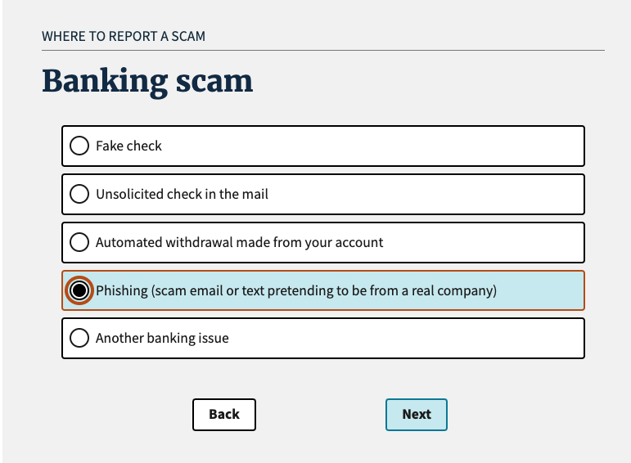
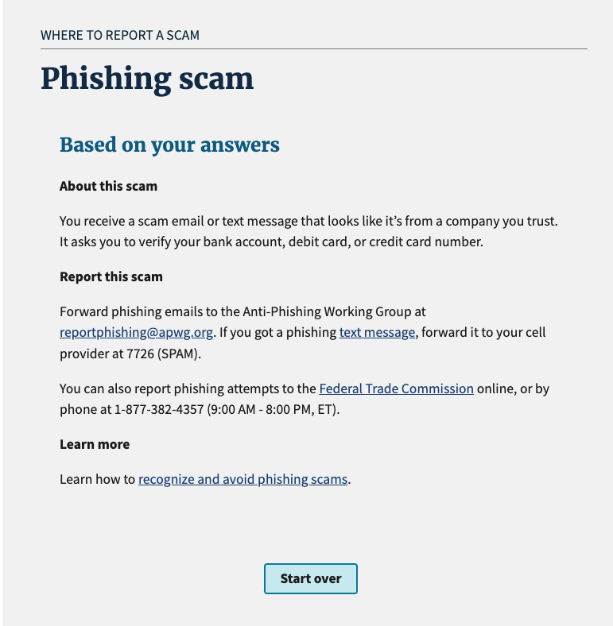
Building the tool

Slide 11
Our usability testing
3
Usability testing

Slide 12



About this usability test
Tested our Scams Wizard prototype
Remote and moderated
30 minute conversational interviews
5 English & 1 Spanish mobile users
4 English & 4 Spanish desktop users

Slide 13
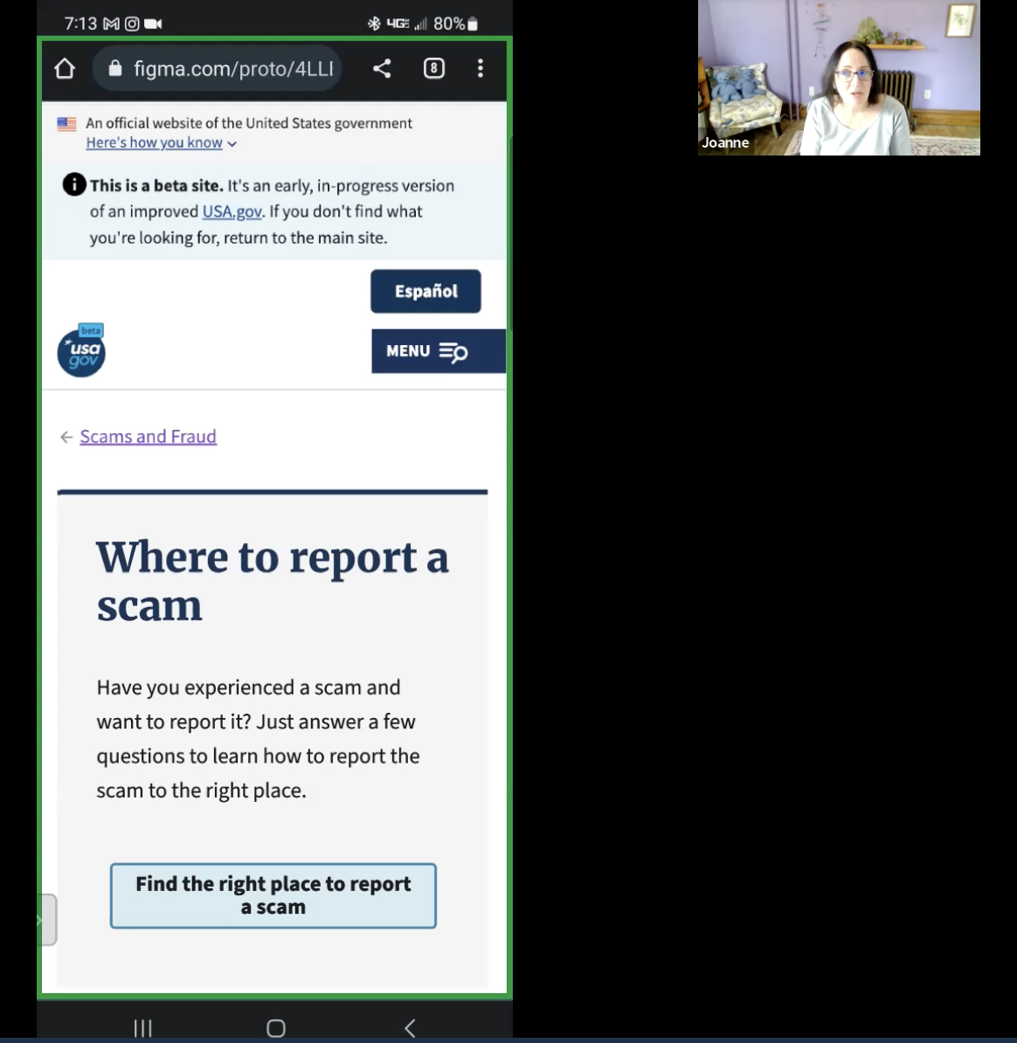
Testing our mobile prototype with a user
Moderator: “Do you prefer the shorter screen, to the point or do you feel like that little bit of extra information would be helpful?”
User: “To a person in this situation I think less is more. If you're having to look through too much information, you start getting a little confused and you even start panicking. The shorter version is right to the point and let’s me know what needs to be handled”

Slide 14
What we learned from this usability test
1
1
Participants highlighted the emotional stage and stressful times when experiencing a scam.

Slide 15
What we learned from this usability test
2
1
2
Participants highlighted the emotional stage and stressful times when experiencing a scam.
By removing unnecessary wording and creating a cleaner wizard, the participants felt calmer.

Slide 16
What we learned from this usability test
3
1
2
3
Participants highlighted the emotional stage and stressful times when experiencing a scam.
By removing unnecessary wording and creating a cleaner wizard, the participants felt calmer.
Most participants prefer the scams wizard because is intuitive, clear, simple, and useful.

Slide 17
Voice user interface
4
Voice user interface

Slide 18

Adapting for voice interface
Adapting for voice interface

Slide 19
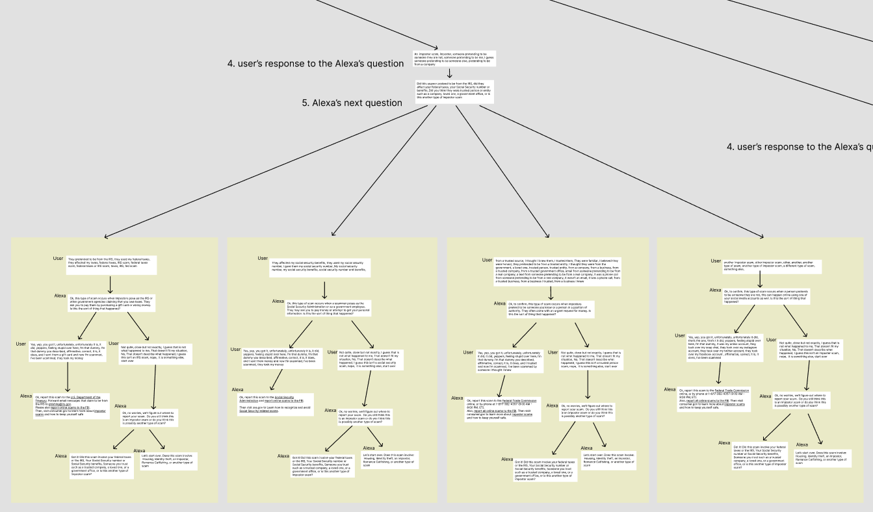
Conversation design

Slide 20
Conclusion
5
Conclusion

Slide 21
Thanks!
Thanks!
Contact joanne.mcgovern@gsa.gov mercedita.andrewnazario@gsa.gov
Follow @USAGov
blog.usa.gov

