Slide 1
Designing with People of All Abilities
June 2021

Slide 2
Agenda
Introductions
Inclusive Design & Accessibility Overview
Accessibility Research Framework
TTS Accessibility Guild Highlights
Inclusive Research
Q&A

Slide 3
How Might We…
Design and work with people with disabilities instead of for them?
Embed Inclusion, Diversity, Equity, and Access (IDEA) in our cultural DNA?
Recognize exclusion at each stage of development, as well, as the hiring processes?

Slide 4
Introductions

Slide 5

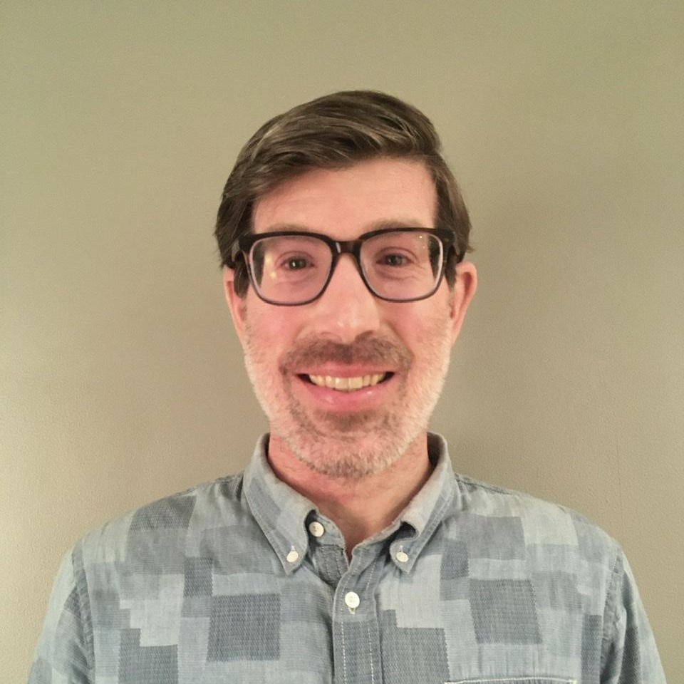
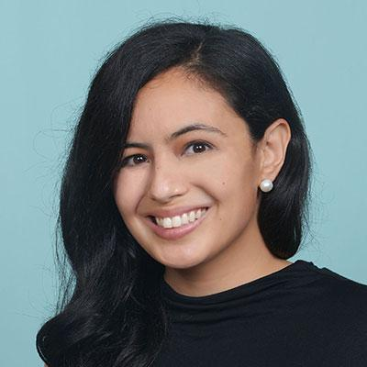
Who are we?
Robert Jolly
Ben Peterson
Pia Zaragoza
Title: TTS Accessibility Guild co-lead (former)
Team: 18F
Specialization: Product management
Title: TTS Research Guild co-lead
Team: 18F
Specialization: UX design research
Title: TTS Accessibility Guild co-lead
Team: Presidential Innovation Fellow
Specialization: Inclusive design and research

Slide 6
Overview

Slide 7
How many people are impacted by disability?
"1 out of 5 people identify as being disabled.
4 out of 5 people care about someone with a disability. Everyone is impacted."
-Christina Mallon
Notes:
CDC 61 million and this number becomes 244,000,000 Americans
328.2 million
Accessibility is a responsibility More than 1 billion people worldwide experience some form of disability. But only 1 in 10 have access to the assistive technology they need, which means many can’t fully participate in our economies and societies. The unemployment rate for people with disabilities is typically twice that of people without. And disability—whether temporary, situational, or permanent—can affect any of us at any time.

Slide 8
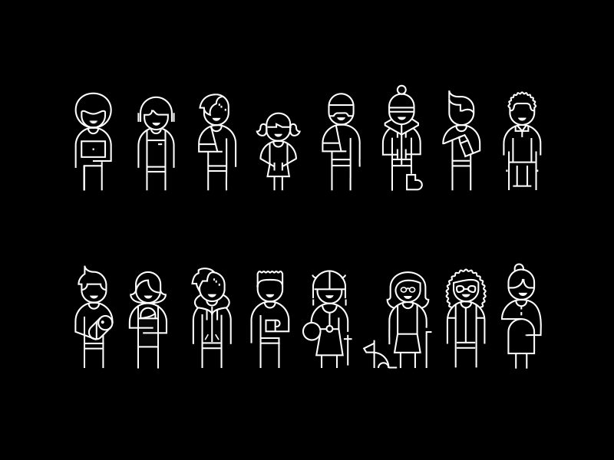
Types of Disability
Cognitive
Auditory
Speech
Mobility
Vision
Illustrations by: Kris Woolery

Slide 9
Key Terms
Universal Design is design that’s usable by all people, to the greatest extent possible, without the need for adaptation or specialized design.
(Ron Mace, universaldesign.org)
Inclusive Design advances accessibility, and encompasses the full range of human diversity including ability, language, culture, gender and age. (OCAD)
Digital Accessibility the measure of a person’s ability to perceive, understand, and interact with a product, service, or an environment
(W3C + Web Content Accessibility Guidelines)
  Perceivable, Operable, Understandable, Robust

Slide 10
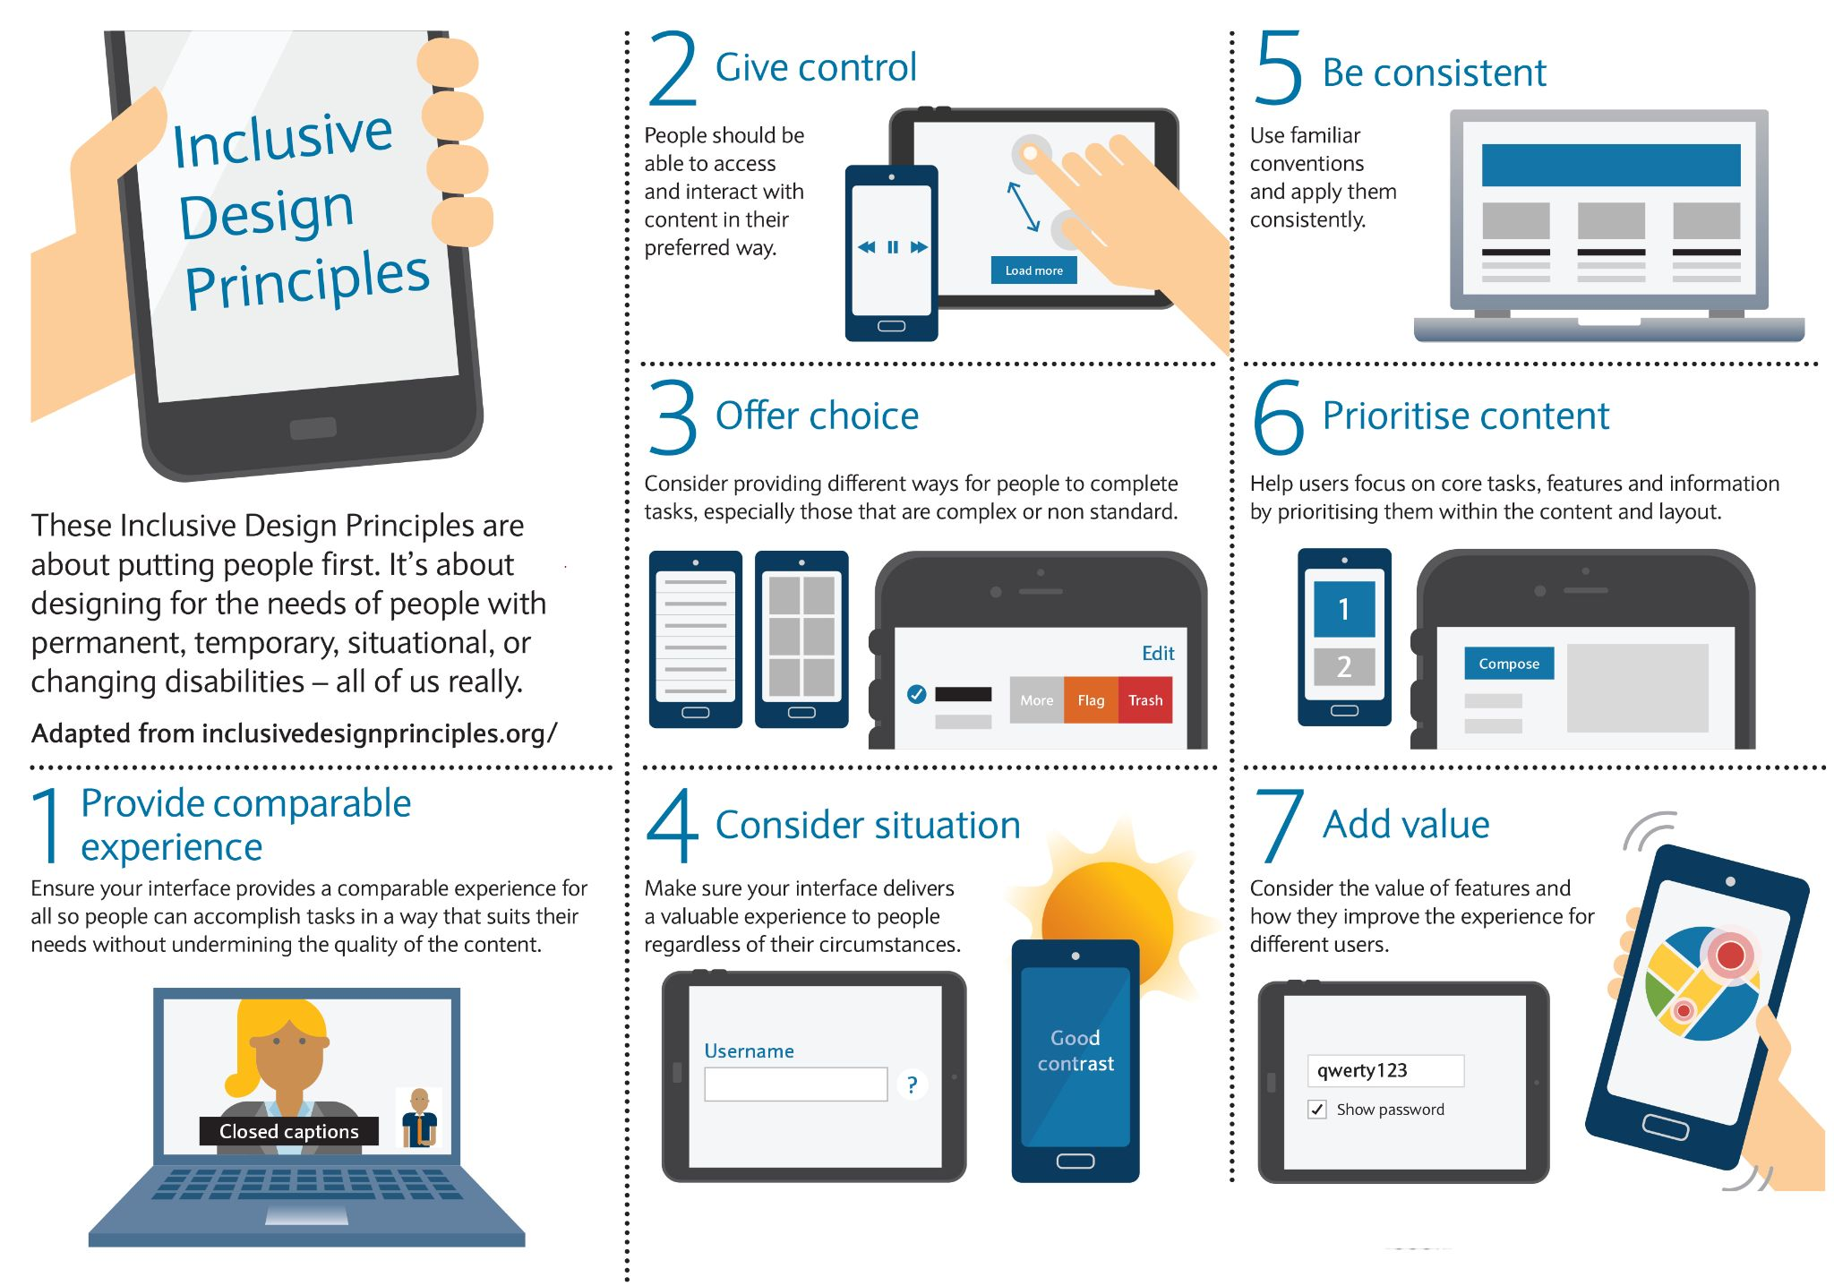
Inclusive Design Principles

Slide 11
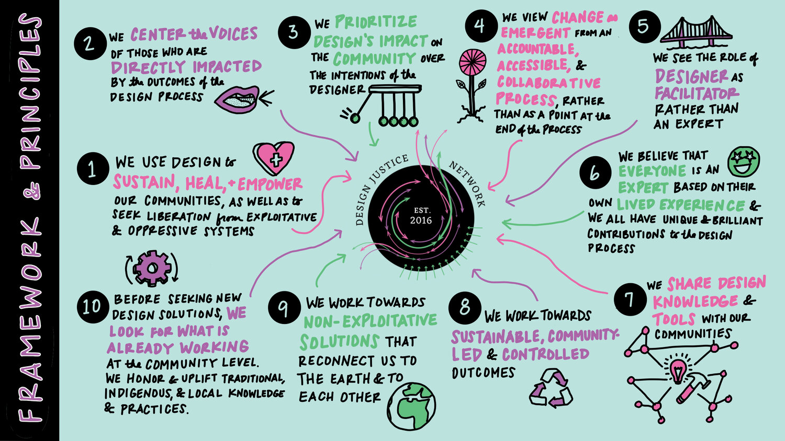
Design Justice Network Framework & Principles
Notes:
https://designjustice.org/read-the-principles

Slide 12
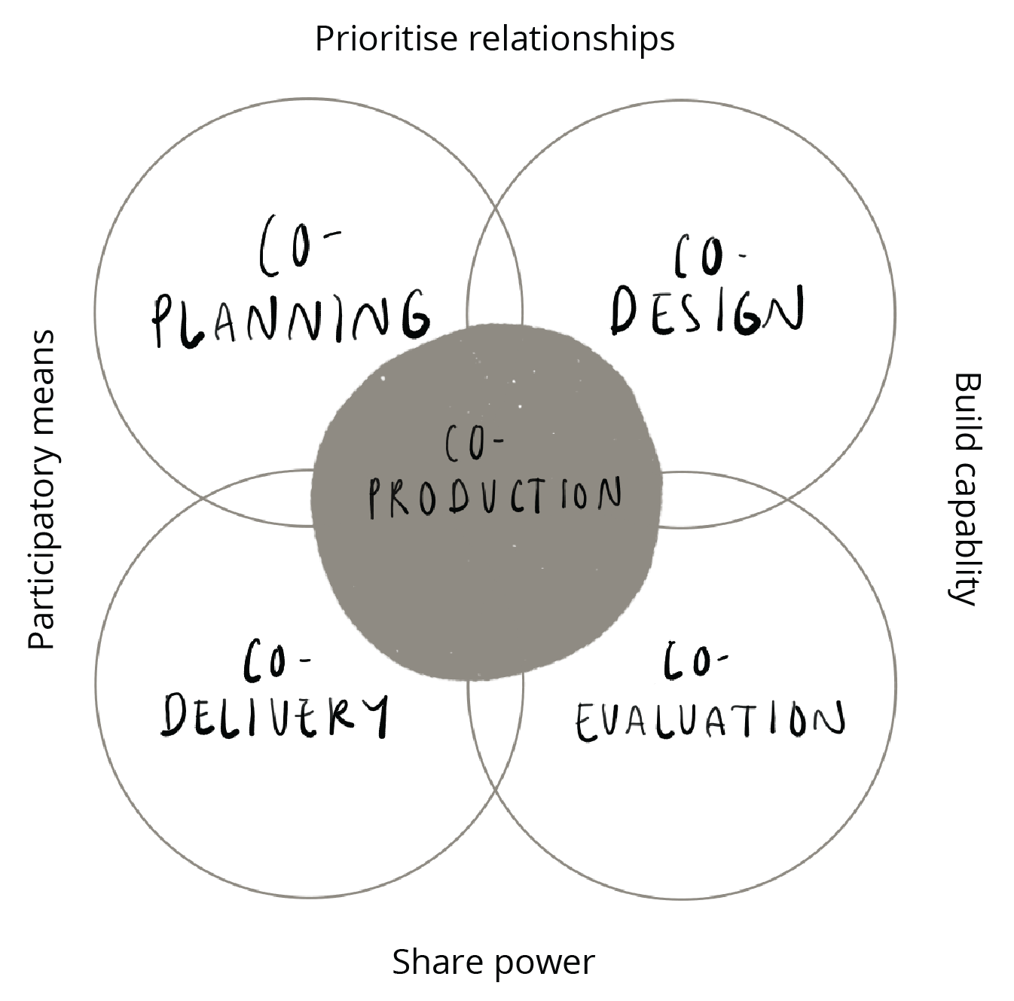
Co-Production
Source: Beyond Sticky Notes

Slide 13
Legislation + Policy
Rehabilitation Act of 1973
Section 508
Americans with Disabilities Act (ADA)
21st Century Video and Communications Act (CVAA)
Air Carrier Access Act (ACAA)
21st Century Integrated Digital Experience Act (IDEA)
Notes:
Systemic Abelism
Laws and regulations that restrict the freedom and equality of people with disabilities.
Social policy that seeks to “care for” disabled people through intensive supervision, protection, and isolation from everyday society.
Policies and practices that seek to reduce or eliminate disability from society.
Source: Andrew Pulrang

Slide 14
DEI&A… or… IDEA
Inclusion: All feel welcomed and valued
Diversity: All the ways we differ
Equity: All having the opportunity to fully participate
Access: Of any and all abilities
Source: Indiana Arts Commision

Slide 15
Applying Accessibility Principles in UX

Slide 16
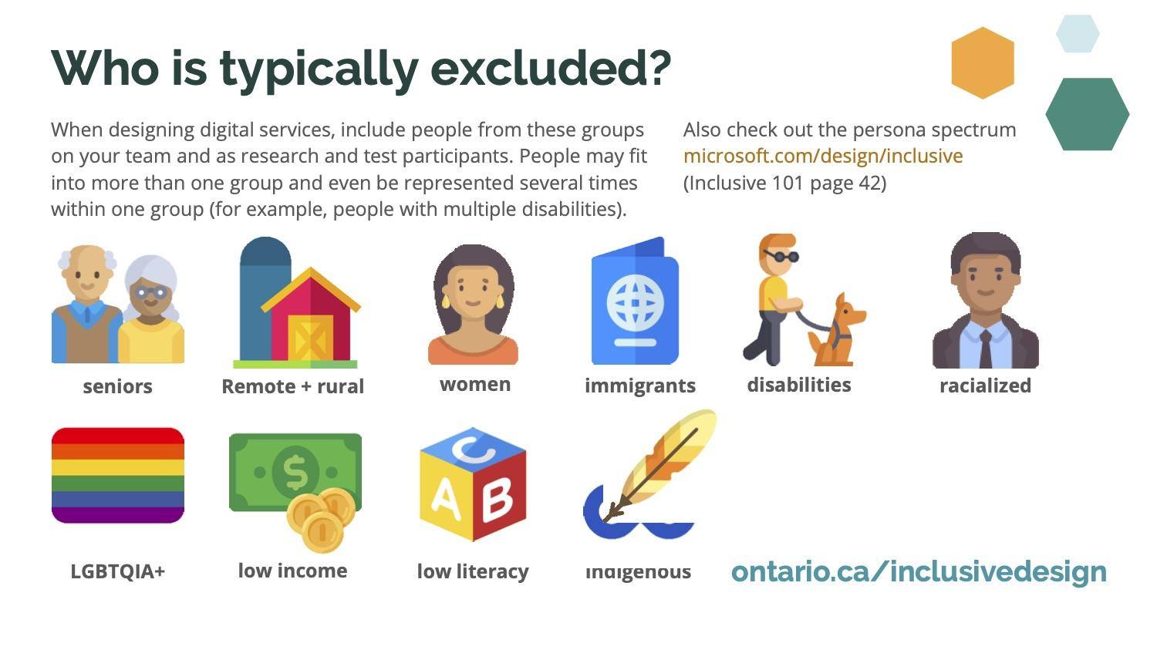
Who is typically excluded?

Slide 17
Dissecting UX
User
-Behaviors
-Needs
-Motivations
Context
-Beliefs
-Desires
-Intent
Experience
-Usable
-Useful
-Delightful
-Accessible

Slide 18
A11y Framework
UX / CX / Human Factors
Perceivable
Operable
Understandable
Accessibility
Robust
Conformance
Compliance
Standards
Governance

Slide 19
Considerations
Ability: having the power, skill, means, or opportunity to do something. (Oxford Dictionary)
Identity: the qualities, beliefs, personality, looks and/or expressions that make a person or group (Wikipedia)
Habits: triggered behaviours in which we engage without conscious awareness or deliberate control. (Creature of Habit: A self-report measure of habitual routines and automatic tendencies in everyday life by Karen D. Ersche, Tsen-Vei Lim, Laetitia H.E. Ward, Trevor W. Robbins, & Jan Stochl)
Preferences: evaluations concerning matters of value, typically in relation to practical reasoning, i.e. questions about what should be done. (Stanford Encyclopedia of Philosophy)
Source: Amy Hurst

Slide 20
Operationalizing Accessibility in UX

Slide 21
Accessibility Zones
Fear
Learning
Growth
Source: Sheri Byrne-Haber
Notes:
Experience
-Usable
-Useful
-Delightful
-Accessible
---
User
-Behaviors
-Needs
-Motivations

Slide 22
Accessibility Zones in Government
Stakeholder Commitment
Training
Scaling
Source: Sheri Byrne-Haber
Notes:
Experience
-Usable
-Useful
-Delightful
-Accessible
---
User
-Behaviors
-Needs
-Motivations

Slide 23
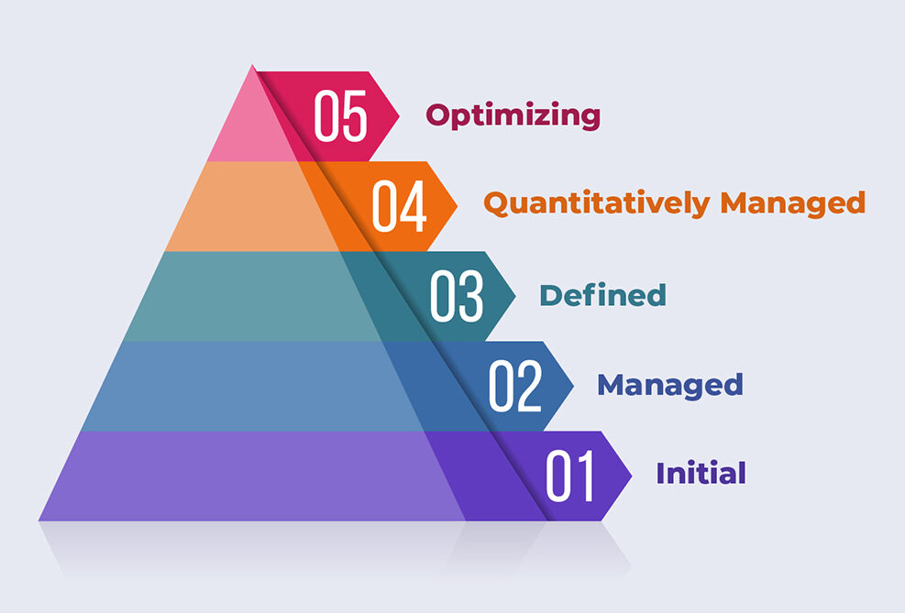
Accessibility Maturity Model – Level Access
Source: Level Access + Sheri Byrne-Haber
Notes:
Experience
-Usable
-Useful
-Delightful
-Accessible
---
User
-Behaviors
-Needs
-Motivations

Slide 24
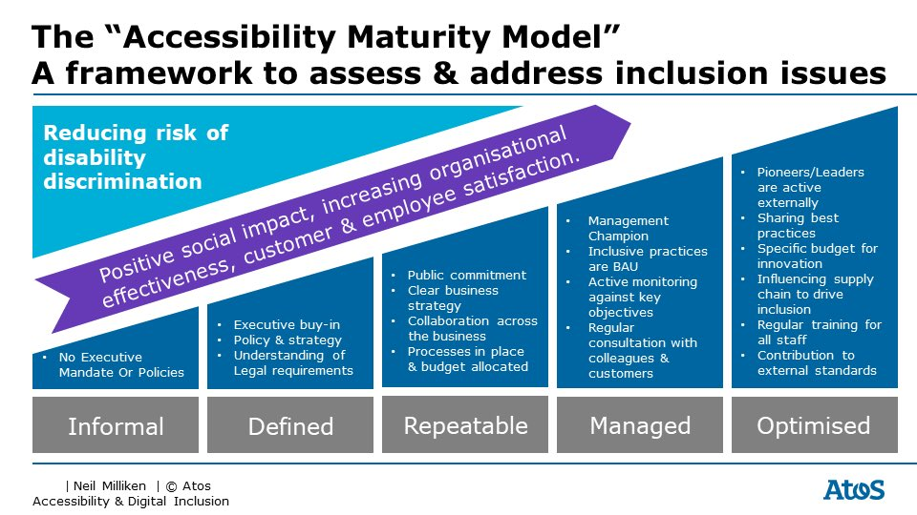
Accessibility Maturity Model - AtoS
Source: Neil Milliken
Notes:
Experience
-Usable
-Useful
-Delightful
-Accessible
---
User
-Behaviors
-Needs
-Motivations

Slide 25
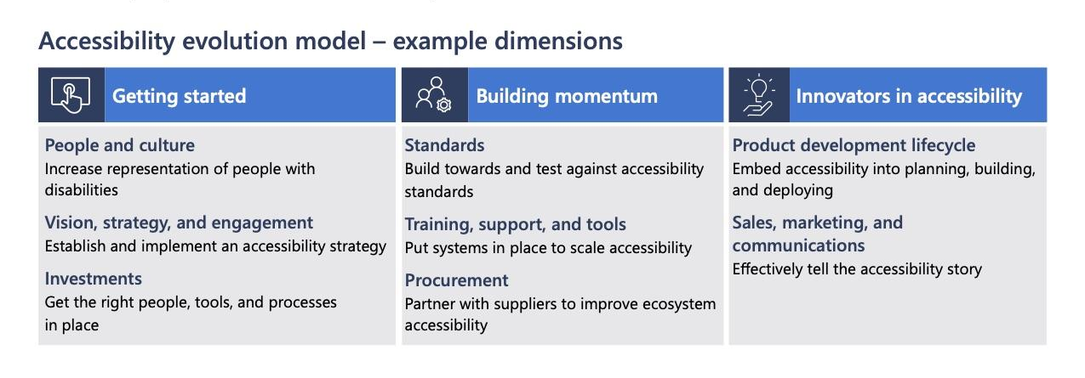
Accessibility Evolution Model
Source: Microsoft
Notes:
Experience
-Usable
-Useful
-Delightful
-Accessible
---
User
-Behaviors
-Needs
-Motivations

Slide 26
Quote from Disability Activists
"Nothing about us,
Without us."
-Disability Activists
Notes:
CDC 61 million and this number becomes 244,000,000 Americans
328.2 million
Accessibility is a responsibility More than 1 billion people worldwide experience some form of disability. But only 1 in 10 have access to the assistive technology they need, which means many can’t fully participate in our economies and societies. The unemployment rate for people with disabilities is typically twice that of people without. And disability—whether temporary, situational, or permanent—can affect any of us at any time.

Slide 27






Disability Inclusion in the Workplace

Slide 28
TTS Accessibility Guild Highlights

Slide 29
What is the Accessibility Guild?
We help TTS develop good, accessible products from the start of production in order to provide an excellent user experience for everyone.

Slide 30
TTS employees generally care about accessibility, but don’t have a complete toolkit for building accessible products.
Problem:

Slide 31
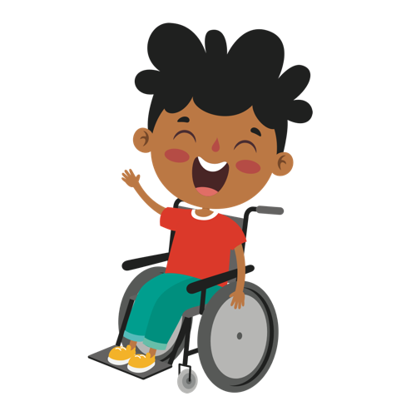

A11y the Slack Bot
A11y the Slack Bot

Slide 32
Many possible solutions
More staff with disabilities
Diverse representation of disabilities at TTS
Inclusive design toolkit
User research with the disability community
Usability testing with disabled users
Manual accessibility testing
More staff who can do 508/WCAG audits
Comprehensive automated testing tools
Role-based guidance for all TTSers
On demand WCAG audits for products
Embed accessibility SMEs on each team
Solution: A lot of possibilities

Slide 33
Two solutions became apparent: manual testing by our staff
More staff with disabilities
Diverse representation of disabilities at TTS
Inclusive design toolkit
User research with the disability community
Usability testing with disabled users
* Manual accessibility testing
* More staff who can do 508/WCAG audits
Comprehensive automated testing tools
Role-based guidance for all TTSers
On demand WCAG audits for products
Embed accessibility SMEs on each team
Solution: We had to narrow our focus
Notes:
With so many possible solutions to the problem, we had to pick one or two to start with

Slide 34
We did a thing!
Robert Jolly (18F), Nikki Lee (18F), and Dave Stenger (USAgov) developed an 8-week course for teaching TTS teams how to manually test a product in accordance with WCAG 2.0/2.1 AA (Section 508+).
Notes:
We created and launched an internal accessibility training program

Slide 35
TTS Accessibility Training Goals
Goal 1: Teach everyone how to run a basic “pre-check-in” audit of a code change.
Goal 2: Teach everyone how to run a full WCAG assessment of a product.

Slide 36
What happened?
We had 8 volunteers to pilot the class!

Slide 37
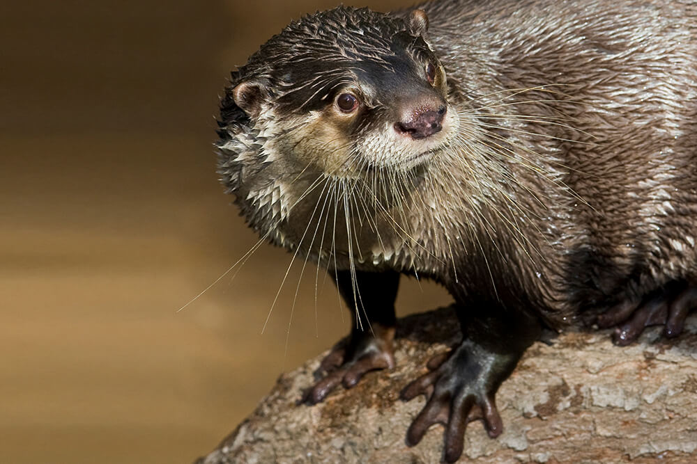
HTML
Display
Course slide: Screen readers read the underlying HTML
<p>Otters are the only serious swimmers in the weasel family. They spend most of their lives in the water, and they are made for it! Their sleek, streamlined bodies are perfect for diving and swimming. Otters also have long, slightly flattened tails that move sideways to propel them through the water while their back feet act like rudders to steer.</p>
<img alt="African clawless otter displaying webbed feet" ...>
Otters are the only serious swimmers in the weasel family. They spend most of their lives in the water, and they are made for it! Their sleek, streamlined bodies are perfect for diving and swimming. Otters also have long, slightly flattened tails that move sideways to propel them through the water while their back feet act like rudders to steer.

Slide 38

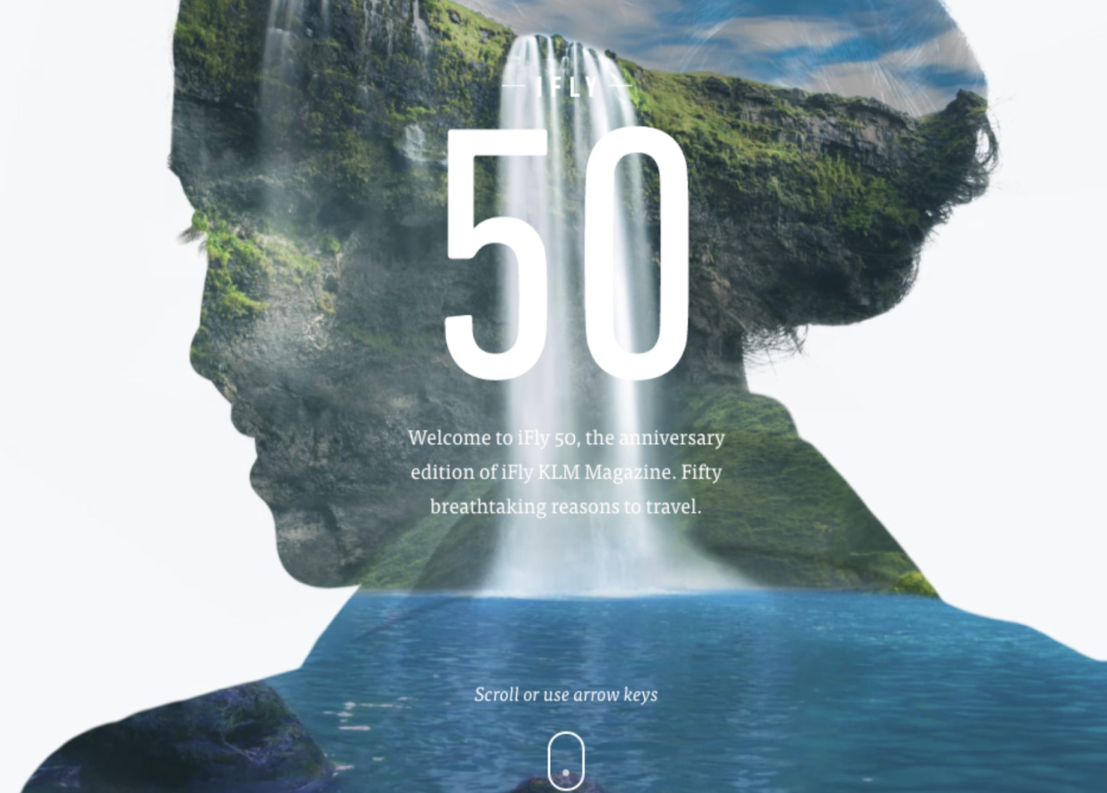
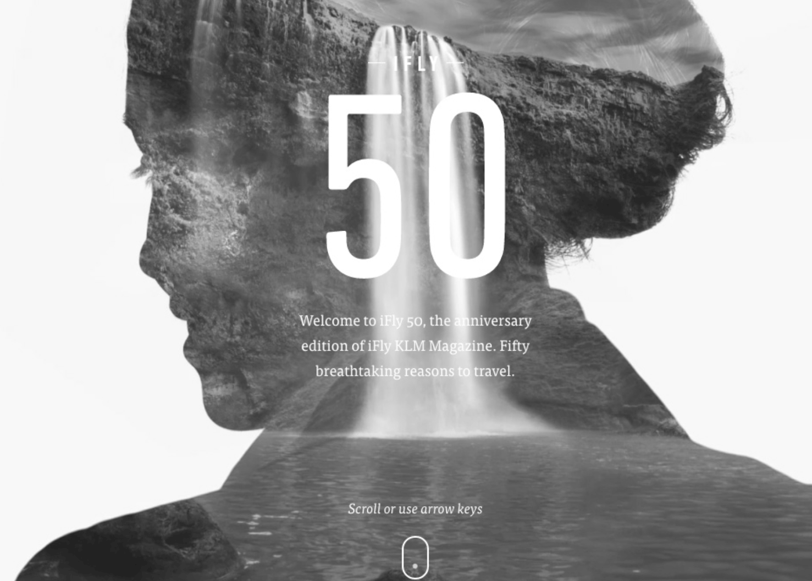
Course slide: Design choices
The design is beautiful, but the text is difficult to read because it has poor contrast against the background.
Full color vision
Monochromacy

Slide 39
Course slide: Landmark roles
role = “banner”
role = “navigation”
role = “main”
role = “complementary”
role = “contentinfo”

Slide 40
How it turned out
Notes:
Robert

Slide 41
Everyone consistently showed up to class, even when their schedules were tight.
* minus a few personal emergencies

Slide 42
Participants gained confidence in being able to spot accessibility issues on their own.
“This has vastly improved my testing, especially with opening up screen readers.”

Slide 43
People told us it was a good use of their time.
“I like this class, and I'm learning a lot!”
“Please keep doing this course.”

Slide 44
“I think it could be helpful seeing manual a11y testing in the context of our work”
“Perhaps consider pairing cohort members together”
We heard constructive feedback.

Slide 45
What we’re doing now...
Notes:
Nikki

Slide 46
We’ve edited the course to incorporate what we learned in round 1.

Slide 47
Things we’re adjusting
Adding explicit “how to test” sections in every lecture
Making homework assignments clearer
Ending the class with testing a code change, and adding a second, deeper dive for full WCAG audits
Pairing people up for homework
And more!

Slide 48
We’ll take folks from good intent to being able to test a code change before it gets checked in and audit the key workflows for their product.
Goals for round 2 of the course:

Slide 49
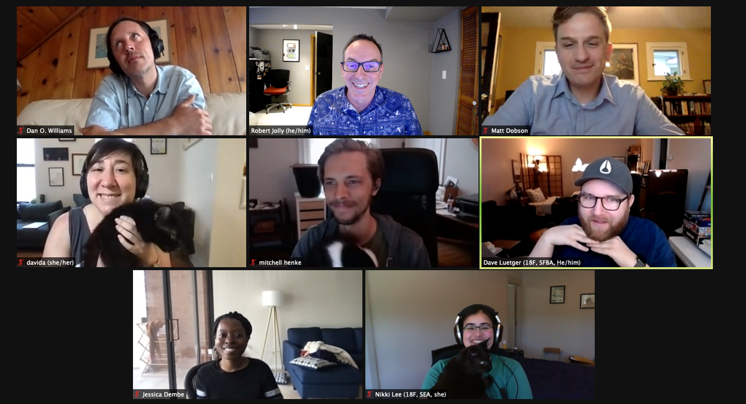
Screenshot of attendees in our online live course.
Notes:
Screenshot of Zoom meeting with the second cohort of TTS Accessibility Training attendees smiling and posing - top row left to right: Dan O. Williams (USWDS), Robert Jolly (18F), Matt Dobson (18F), middle row left to right: Davida Marion (18F), Mitchell Henke (Login.gov), Dave Lueteger (18F), bottom row left to right: Jessica Dembe (18F), Nikki Lee (18F)

Slide 50
This helps incorporate inclusive design within teams’ thinking and processes.
But it’s only part of the story.

Slide 51
We want teams to move beyond designing for people with disabilities.

Slide 52
Valuable usability insights happen when we are designing with people with disabilities.

Slide 53
Inclusive Research
Notes:
53 This is Ben speaking.
I’m going to briefly talk about some of the ingredients for Inclusive Research we’re thinking about at TTS.

Slide 54
Respecting participant’s time
Some basic things to review:
Check descriptive labels
Test the navigation
Adjust color settings
Notes:
54 Respect your participants time by checking as many accessibility issues you can before testing with people, so they are not doing a basic accessibility scan for you or telling you something you can find out without a testing session.
Some basic things to check include: Running Accessibility software to catch any unlabeled or not descriptively labeled buttons or images
Test Navigation and zoom. Can you navigate using the keyboard only? What happens if you set zoom to 200%? Does the text get cut off or overflow?
Robert mentioned adjusting for color. Does your design still work with inverted color or high contrast mode?

Slide 55
Adjusting research for accessibility
Use live prototypes when possible
Create inclusive discussion guides
Budget more time per task
Set expectations ahead of the session
Notes:
55 Conduct research with accessibility in mind.
Use Live Prototypes when possible
which allow people who use assistive technologies to interact with your design.
Write your discussion guides to be as inclusive as possible.
In your directions to participants can you say things like "activate" instead of "click on" to account for different ways of accomplishing a task.
Budget more time per task.
Focus on the highest priority tasks to test so you can learn from participants experience without making the test longer.
And Set expectations ahead of the session
by telling people about known accessibility issues that they will run into, and what you’ll content be covering.

Slide 56
Recruiting practices
Recruit as diverse a group of participants with a range of different disability types that will help you understand a full picture of the friction your design creates for everyone.
Notes:
56 when we talk about recruiting - we’re talking about engaging as diverse a group of participants, with a range of different abilities that will help you understand a full picture of the friction your design creates for everyone .
Taking it a step further, can you recruit more than one person with similar abilities to avoid relying on solely one person’s experience of an issue.

Slide 57
Expanding recruiting
The most common ways for to recruit for research are:
within our networks
with a recruitment and usability testing platform
Notes:
57
That said our common recruiting practices prevent us from achieving this diversity.
we commonly recruit for research through personal networks, social media or with a recruitment platform. When we recruit from our own networks we tend to get participants who have similar backgrounds to us. When we use a 3rd party recruiter, we’re limited to their pool of participants.
We’re just starting to test working with community groups to see if we can build relationships with them. Just as with recruiting agencies, we’ll pay a fee for their time to help with recruiting. In this way, we’d get research participants who are representative of the communities we’re trying to reach and support the work of these community organizations.
Working with community groups has been years in the making for our team and has been the collective effort of dozens of people, many who are no longer at 18F. These things take time and require investment but they are conversations worth having if we are serious about diversity and inclusion.

Slide 58
Power imbalances between researcher and participant
How can we shift decision making into the hands of those who will be the recipients of what we create?
Notes:
58 We’re also asking ourselves,
What power do we have in the process and how can we share our power with our participants?
Can we exist as facilitators of a process? Putting decision making directly into the hands of the people who these designs are for, And who will have to use them?

Slide 59
The earlier in the design process that participants are included, the better chance you have of meeting their needs.
Notes:
59 One decision that might be within your power is when to include participants in your work. The earlier in the process, the better chance you have of meeting their needs.
Can you bring participants in before you start building, to help frame your research plan and design hypotheses? Is the prototype you're testing the best way to meet the goals of your users? What would your users want to test?

Slide 60
How do we measure success?
What power do we have to change how we work?
Notes:
60 The two questions I’d like to leave you with are
How do we measure success?
and
What power do we have to change how we work?
As designers, what parts of the process do we control or influence?
And can we measure our success by how we share our power and make our practices more inclusive?
Thank you.
now we’ll go to Q and A

Slide 61
Q&A

